Slide 1

Milk of life drink

Slide 2


Preface
benefit
1. contains nutrients and therefore helps the body to grow.
2.drinking milk helps to be healthy and strong. Helps to strengthen immunity.
3. Milk helps to increase energy for the body.
4. Milk helps the develop brain.

Slide 3
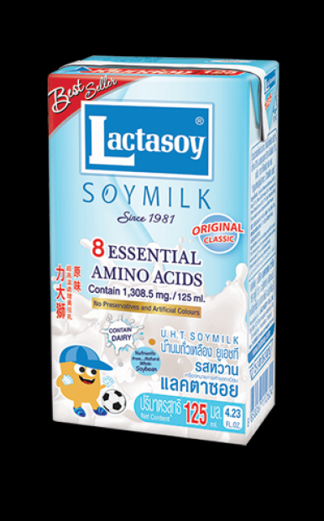
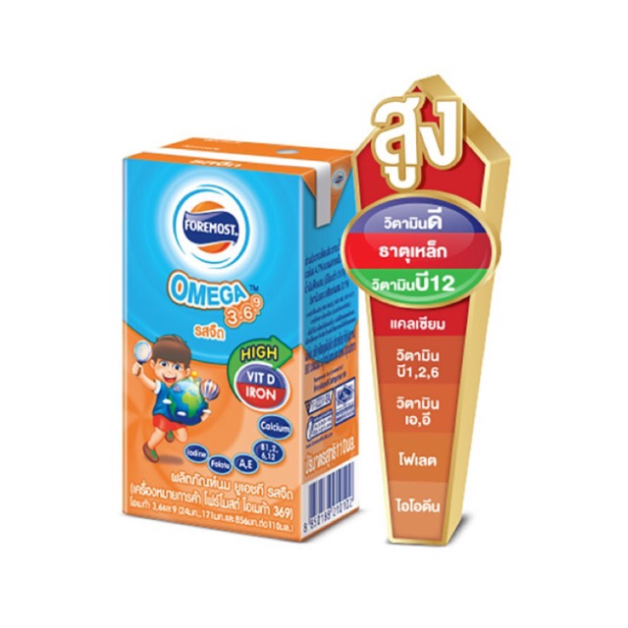
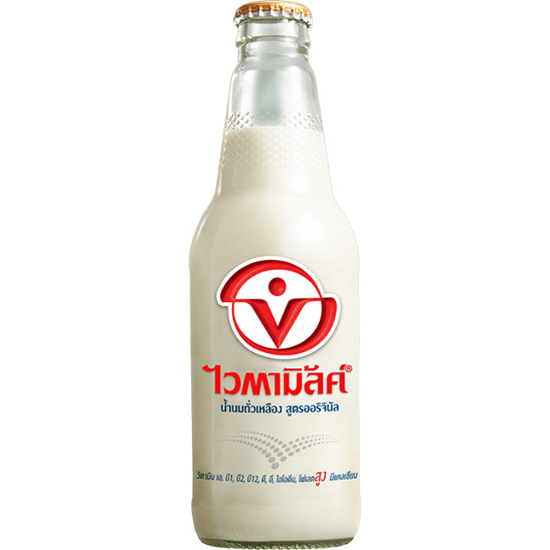

The topic
1.brand
2.cost
3.Amount
4. benefit

Slide 4

Mr.Naratip Sangjanda
NO.61030238

